Slide 1

Training, Straining, and Tendon Science
Jonathan hodges, dpt

Slide 2
Objectives
Develop a fundamental understanding of Acute:Chronic Loading
Establish the science behind tendon strains vs tendinopathies and related interventions
Establish the best programming to reduce injury risk.

Slide 3

The issue with Bigger, Faster, Stronger
strength
power
flexibility
“Better” Architecture
Playing Time
Teams
Practice
Exposure
Notes:
Maybe we can, in fact, reduce the rate of of injury per exposure but by doing so we allow the athlete the opportunity for more exposures. No magic bullet. The approach must be multifactorial and focused on reducing risk, not injury prevention.

Slide 4
Training Variables
Volume (How Much)
Intensity (How Hard)
Time (How Long)
  Training history
  Acute bout
Still Volume!
Notes:
If we start getting these variables out of check, injuries happen. Telling an athlete to start with 50 miles a week or with max sprint repeats is ludicrous. If you’re gonna be dumb ya gotta be tough

Slide 5
Strains and Tendinopathies are Both Training Injuries!
How Much Stress Can An Athlete Take?
Notes:
Non contact injury means you were not ready to do what you were trying to do. We also know that tissue healing is a finite process that we have little overall effect on. This lets us frame our return to sport criteria better and work on rehab more as “training.” The goal is to increase the volume in the case of distance and the intensity in the case of sprinting without causing injury.

Slide 6
Strains and Tendinopathies
Strains-Acute overload
  Inability to take intensity (more volume of intensity)
Tendinopathy-Chronic overload
  Inability to take volume
We Need Overload to Progress

Slide 7
Training Volume
Some
Adaptation
Not Overwhelming
MRV
No Adaptation
Net
Negative
Notes:
Homeopathic doses vs beating athletes in to the ground

Slide 8
Acute on Chronic Training Loads
Load of 1 Microcycle
Average Load of the Previous 4 weeks
Windt & Gabbett
2016

Slide 9

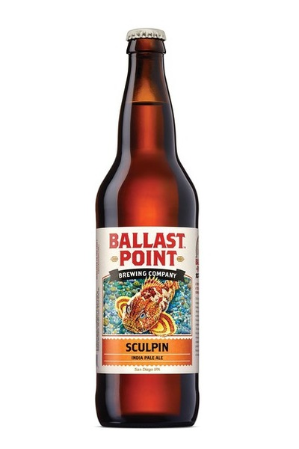



Acute on Chronic Training Loads
Blanch & Gabbett 2015
Drinking
Drinking
Notes:
It’s funny that we accept the consequences of a night out on the town costing us the next day but are befuddled when we dramatically increase training intensity and get hurt

Slide 10
Acute:Chronic
Case Study
Hamstring Strain
  30 meters of sprints over 30 min workout (1.0m/min)
  Week 2-3: 750 meters/30min (25m/min)
  Re-Injured week 4

Slide 11
How do we establish Load PArameters?
* External (Time)
* Internal (RPE)
* Time x RPE = AU (Arbitrary Units)
Chronic Load is a ROLLING average of the previous 4 weeks.
Keep Acute load under 1.5 x Chronic Load

Slide 12
Acute on Chronic Training Load
(Reality)
Preseason
Full Clearance
Work Load
Start of Season
Return to Sport
Off Season
Rehab
Time
Notes:
Mention how overall training load decreases as we age (often). Analogy to going from practicing twice a day to play recreationally once a week. If an athlete is going from 2 sessions/week to 5-6 that is a dramatic ramp up in intensity AND VOLUME, not to mention if this includes the typical two a days we see at the start of a season in some sports

Slide 13
Acute on Chronic Training Load
(Ideal)
Preseason
Full Clearance
Work Load
Start of Season
Return to Sport
Off Season
Rehab
Time
Notes:
Mention rest can be useful after an acute injury

Slide 14
Acute Injuries
(Strains)
Clear(ish) Diagnostic Criteria/Fuzzy Rehab and RTS

Slide 15
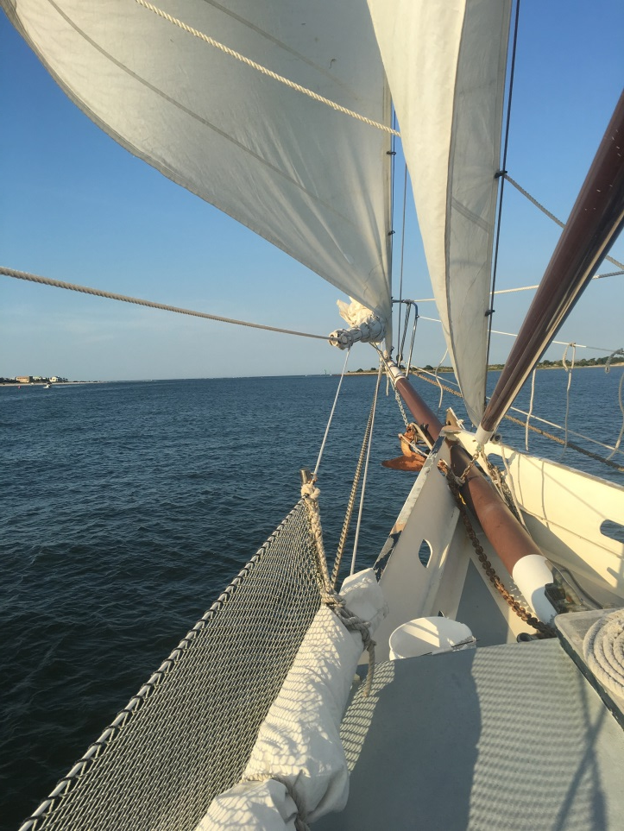
Muscle Strain (MOI)
High Speed Running
  Biceps Femoris (~80%)
Extensive lengthening
  High Kicking, Sliding tackle, Split
  Semimembranosis
Notes:
Can we predict when it may happen?

Slide 16
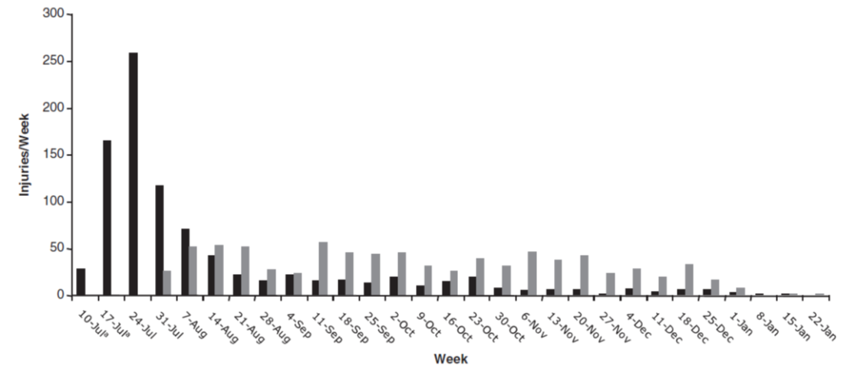
Elliot et al 2011
10 Year NFL Strain Injury Rate
Notes:
Athletes do not need to be “fast” in the preseason, especially if they have been idle in the time leading up to it. Even if we take an athlete who has been doing speed work, if the base is not there it is problematic
Study of Rugby injuries by Brooks in AJSM showed 22% of training took place in the preseason but accounted for 34% of the injuries during the entire season

Slide 17
Rate Limiting Factors
(> 4 weeks RTS)
VAS >6
Pain with ADLs >3 days
Pop felt at injury
Bruising
>15 degrees ROM difference
Tender to palpation
Pain with isometric contraction
Pain with passive SLR
53% Sensitive
95% Specific
Notes:
Guillodo et al. Clinical Predictors of time to return to competition after hamstring injuries

Slide 18
Rehab
Concentric Contraction MVIC
  Leg Curl 120.7% MH
  SL Bridge 99.3% BF
  Lunge 21.4% BF
  Lunge 18.1% MH

Slide 19
Rehab
Eccentric Contraction MVIC
  Nordic Hamstring 101.8% MH
  Nordic Hamstring 71.9% BF
  Hip Hinge 10.7% BF
  Hip Hinge 11.6% MH

Slide 20
Eccentrics as a Protective Effect
Petersen et al 2011
NNT for acute injury
  13
NNT for new injury
  25
NNT for recurrent injury
  3
3.8 vs 13.1 per 100 player seasons
Notes:
MAJORITY OF INJURIES OCCURRED IN PRESEASON IN BOTH GROUPS
9 of 15 in intervention group
12 of 52 in control group

Slide 21
Chronic Injuries
(Tendinopathy)
Fuzzy Diagnostic Criteria/Clear(ish) Rehab and RTS

Slide 22
Tendinopathy
Normal Tendon
  Regular Collagen Fibers
  Minimal Vascularity
  Spindle Shaped Tenocytes
Tendinopathic
  Disorganized Collagen Fibers
  Vascularity and Nerves
  Round Tenocytes
Notes:
Any modality that seeks to increase blood flow to a tendon could be moving it more towards tendinopathic changes. Reactive tendinopathy is reversible degenerative is not. That does not mean degenerative cannot be improved histologically and symptomatically but typically degenerative are not painful, more reactive on degenerative EXPLAIN REACTIVE ON DEGENERATIVE

Slide 23
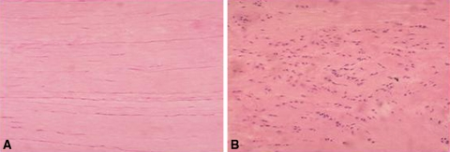
Tendinopathy
Xu, Y et al “The Basic Science of Tendinopathy”

Slide 24
Tendinopathy
Cyclic loading
  Running
  Jumping
  Too many MetCons?
Endurance athletes
Dramatic increase in volume

Slide 25
Tendinopathy
Cyclic loading causes tendinopathic changes!
  Increased angiogenic factors (VEGF)
  Increased matrix degradation (MMP family)
  Increased inflammation (IL-6, COX-2)
  Increased cell rounding
  Changes do not occur in entire Tendon!!
  Not Necessarily Symptomatic
Notes:
Which means we can possibly reduce the risk of it ever becoming symptomatic. Mention one study where they cyclic loaded and caused increase in TIMPs that did so by using 6% strain. Equivalent of 1000 loaded squats vs 1000 steps
Changes do not occur in entire tendon as it relates to reactive versus degenerative tendinopathy. Allude to the fact of nonspecificity of passive modalities over tendon.

Slide 26
Mechanically Compromised Tendon
Optimized Load
Optimized Load
Unloaded
Excessive Load
Individual Factors
Normal Tendon
Adaptation
Excessive
Load
Modified Load
Strengthen
Reactive Tendinopathy
Degenerative Tendinopathy
Reactive on Degenerative Tendinopathy

Slide 27
Absolute Rest?
Causes tendon degradation
Decreased Musculotendinous Strength
Screws up Kinetic Chain
Decreased Neuromuscular Performance
Notes:
Strength of any tissue will only be as great as the load placed upon it!

Slide 28
The Continuum
Return to Sport/Risk Reduction
?????
Recovery
ECC Vs HSR
Isometrics
Time
Pain

Slide 29
Heavy Slow Resistance Training
First establish irritability
Traditional Alfredson Protocol (3x15) used on untrained patients.
HSR: 3-5 second concentric and eccentric contraction
Decreased time compared to eccentric protocols
Progressive Loading
Beyer Protocol:
  3x15 rep max (RM) week 1
  3x12 RM weeks 2 and 3
  4 x10 RM weeks 4 and 5
  4x 8 RM weeks 6 to 8
  4x6 RM weeks 9 to 12
    2-3 min rest between sets
    RPE of 8 on last 2 reps

Slide 30
Reduction of relative risk of injury
Strain risk reduction
  Need to warm up to the season and the session
  Strength train (Eccentrics)
  Think of intensity (especially volume of intensity) as a math problem
Tendinopathy risk reduction
  Think of volume as a math problem
  STRENGTH TRAIN
Notes:
No more than 1.5x increase in volume over the course of a week

Slide 31
Heavy Slow Resistance Training
Increased growth hormone (Doessing et al 2010)
  Collagen synthesis
Increased fibril density (Kongsgaard et al 2010)
Increased endostatin (Pufe 2005)
  Decreased angiogenesis
Increased anaerobic threshold (Weyand and Bundle)
Increase hamstring CSA (Every resistance training study ever)
Notes:
Remember Weightlifting is a weight class sport! Your athletes will not get bigger unless they dramatically alter their nutrition habits as well.

